Slide 1






360° Optical Flow using Tangent Images
Mingze Yuan and Christian Richardt
University of Bath
EP/S001050/1
EP/M023281/1, EP/T022523/1

Slide 2
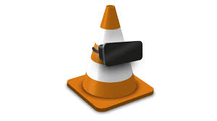
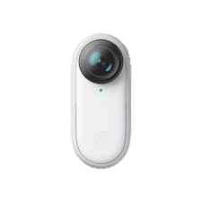
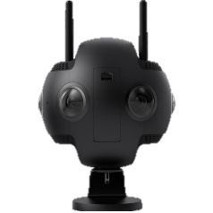
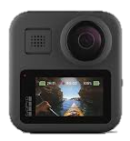
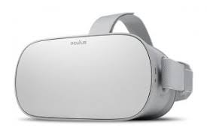
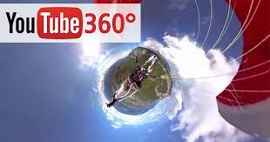
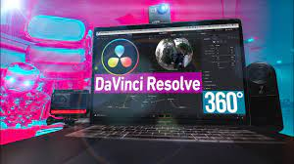
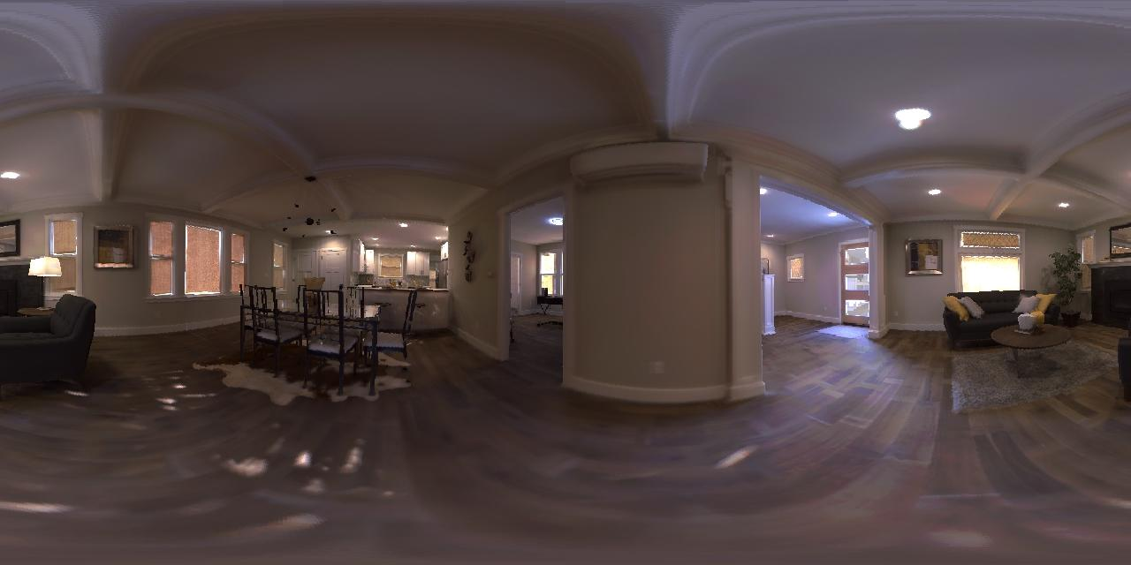
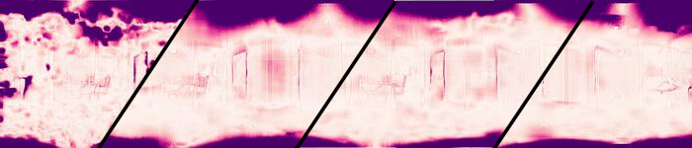

Motivation
360° Cameras
360° Media Distribution
360° Media Display
Need Optical Flow!
DIS
PWCNet
OmniFlow
RAFT
Optical Flow Error Heatmap (darker = larger error)
360 Optical Flow using Tangent Images, MZ Yuan and C Richardt
BMVC 2021
Page 2
Notes:
360° images and videos are becoming increasingly ubiquitous as they are supported by evermore 360° cameras, media distribution platforms and displays.
Optical flow is necessary data for many 360° media processing tasks.
The unique distortion of 360° images is not supported by existing perspective optical flow methods, which show large errors, especially at two poles.

Slide 3
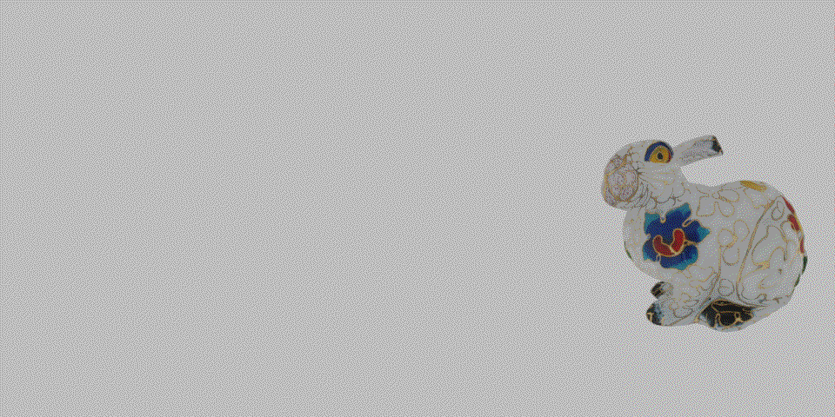
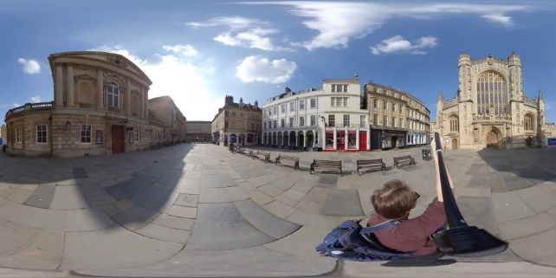
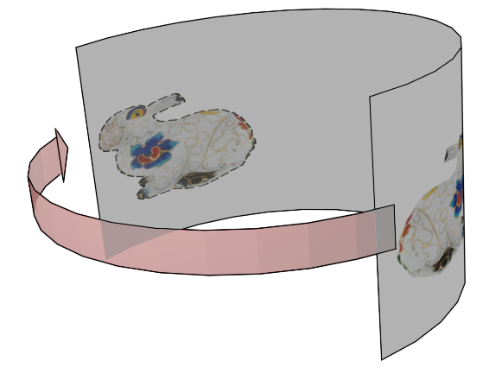
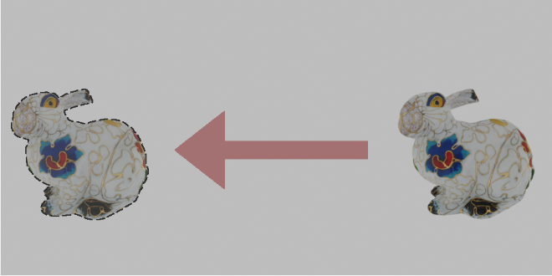
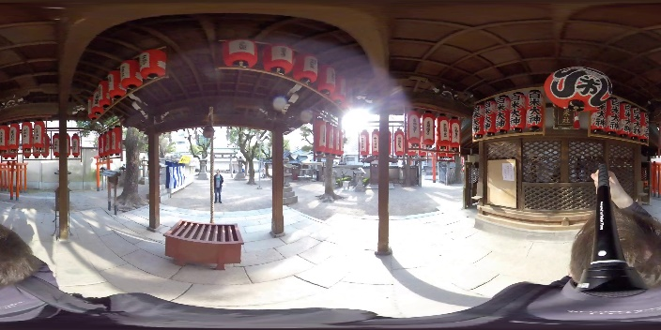
Problems – 360° optical flow definition
Motion
Perspective Image Optical Flow
360 Image Optical Flow
Problem 1: Large Distortion
Problem 2: Wrap-around
360 Optical Flow using Tangent Images, MZ Yuan and C Richardt
BMVC 2021
Page 3
Notes:
Compared to perspective images, the commonly used equirectangular projection of 360° images introduces two key problems.
First, large distortions near the poles at the top and bottom of the images.
Second, the wrap-around from the left to the right edge of images.
To solve the wrap-around problem, we define 360° optical flow to be the shortest geodesic distance on the sphere.

Slide 4
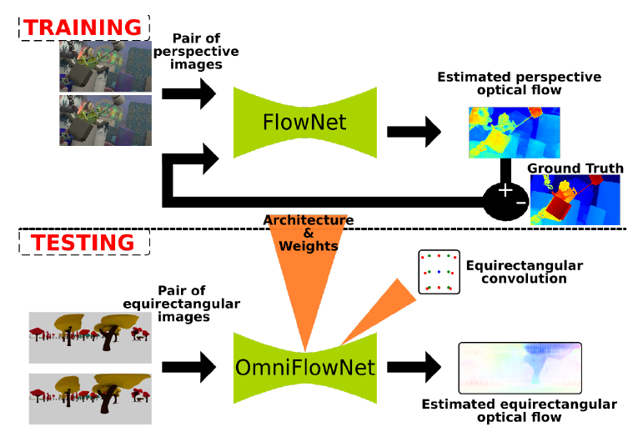
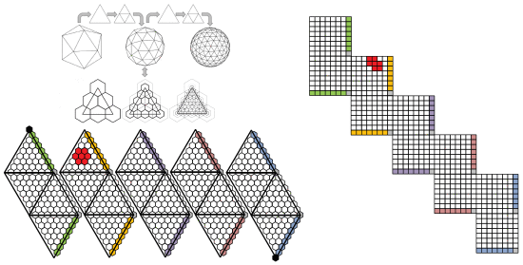
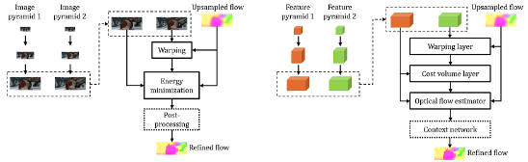
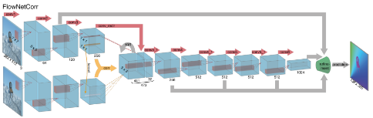
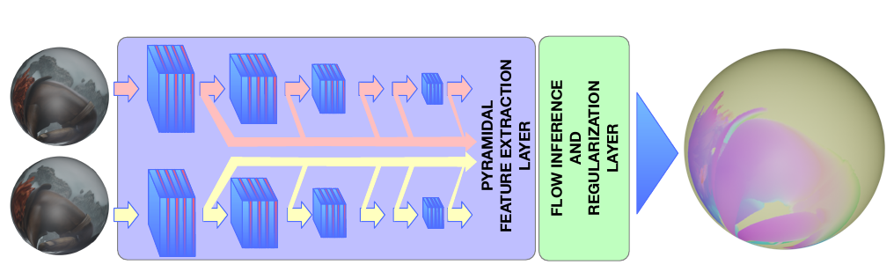
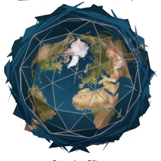
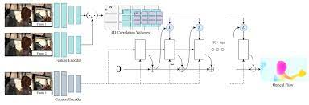
Related Work
PWC-Net
OmniFlownet
(Artizzu et al. ICPR 2021)
Luo et al. 2019
FlowNet
360OpticalFlow
(Bhandari et al. ICPR 2021)
RAFT
Eder et al. CVPR 2020
360 Optical Flow
Perspective Image Optical Flow
Tangent Image
360 Optical Flow using Tangent Images, MZ Yuan and C Richardt
BMVC 2021
Page 4
Notes:
CNN-based 360° optical flow methods are limited by the size of GPU memory, and therefore cannot process high-resolution images.
And perspective optical flow methods are not aware of 360° image distortion.
Inspired by tangent-image-based methods, we propose a tangent-image-based method for high-resolution 360° optical flow.

Slide 5
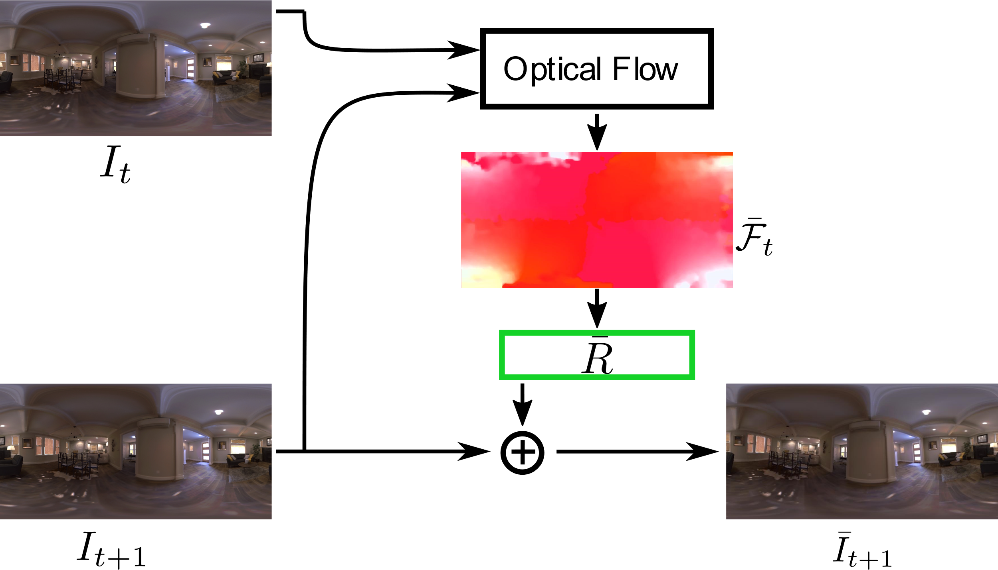
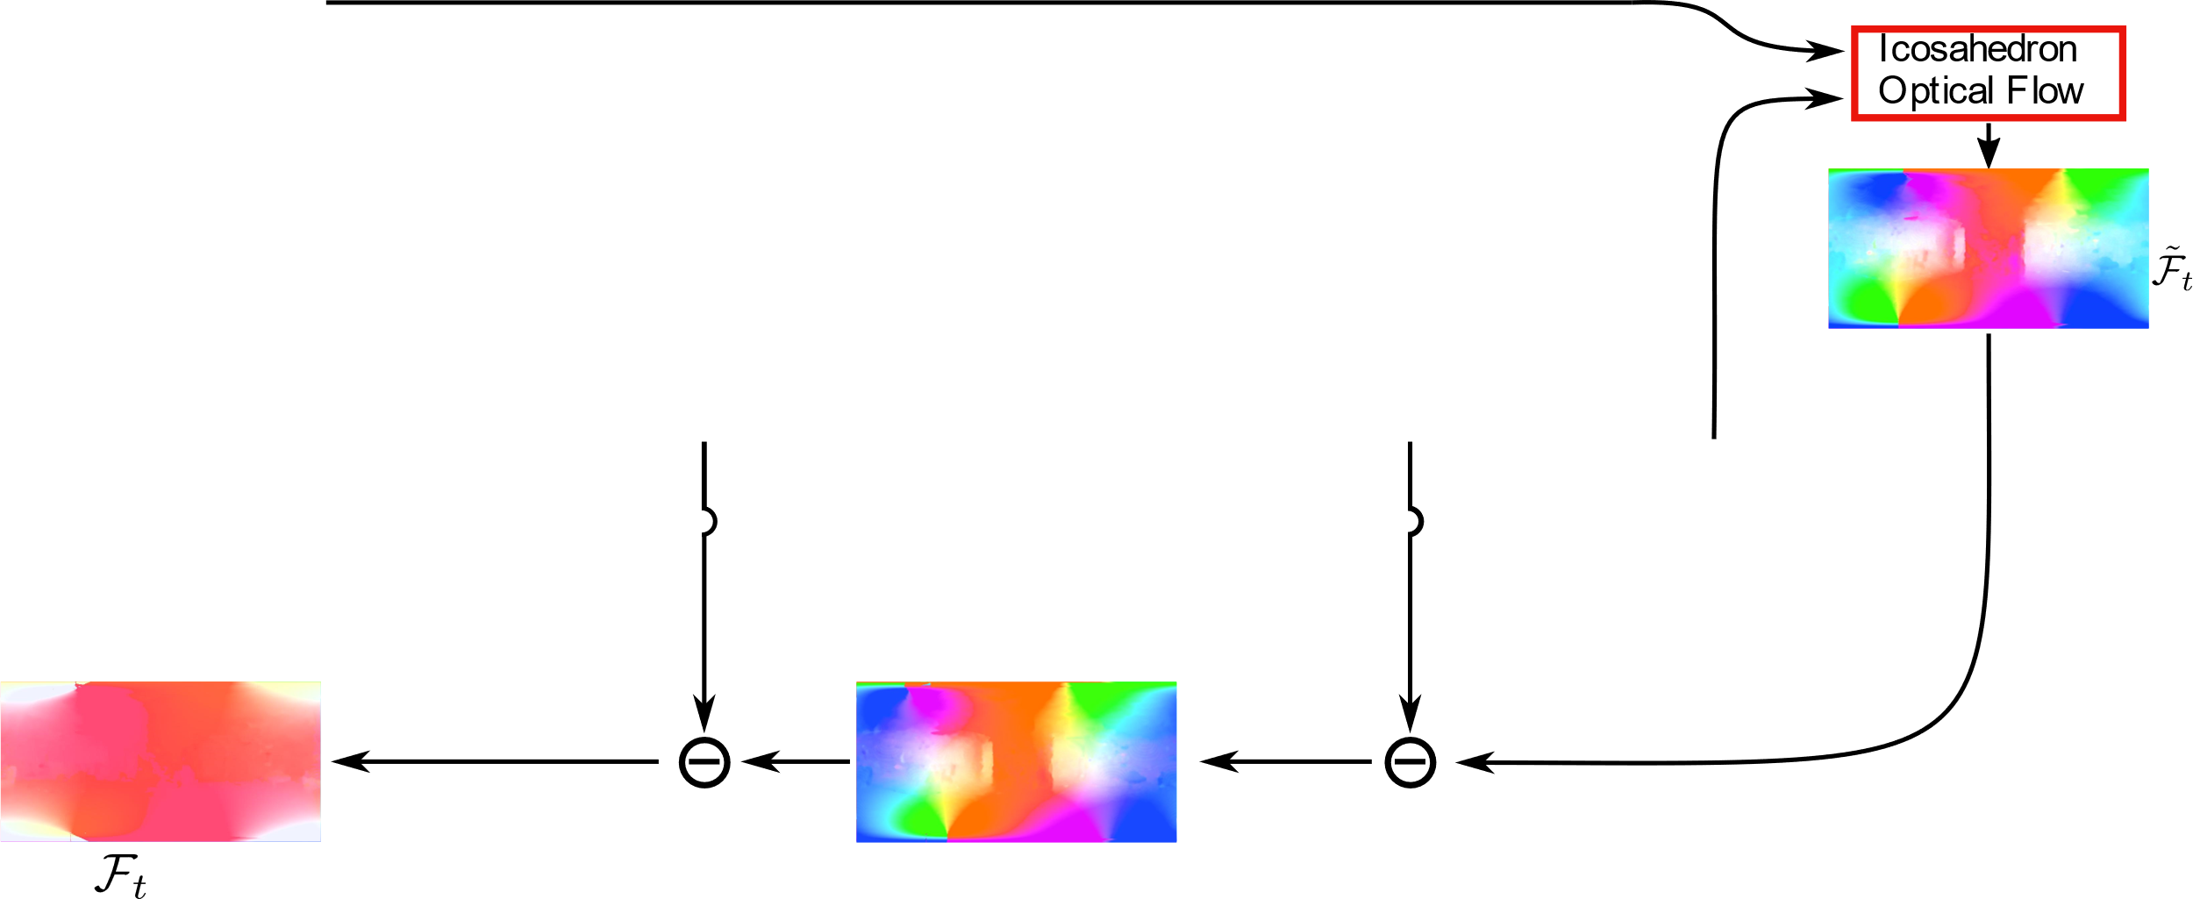
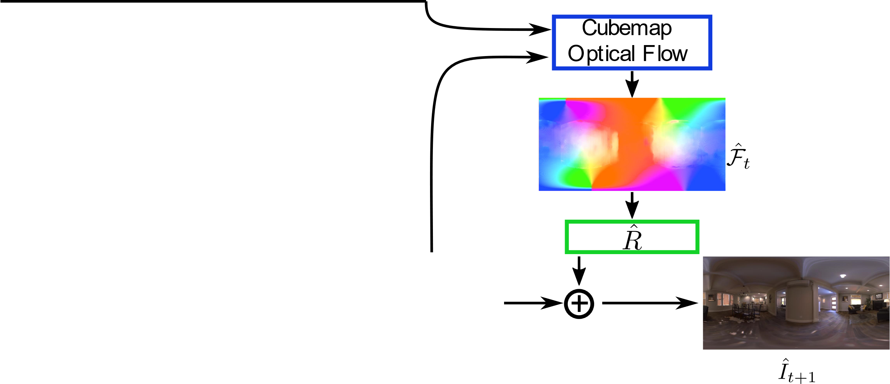
Method – Pipeline
360 Optical Flow using Tangent Images, MZ Yuan and C Richardt
BMVC 2021
Page 5
Notes:
The key idea is to use gnomonic projection for extracting perspective images from 360° images,
and to use global rotation warping for mitigate the relative motion between two images.
Our method composes of 3 steps.
The first step uses the ERP [equirectangular?] optical flow to align the target image to the source image.
The second step uses cubemap optical flow to reduce 360° image distortions.
The third step uses icosahedron optical flow to refine the local detail of optical flow, which is fused into the final 360° optical flow with the global rotation warping.

Slide 6
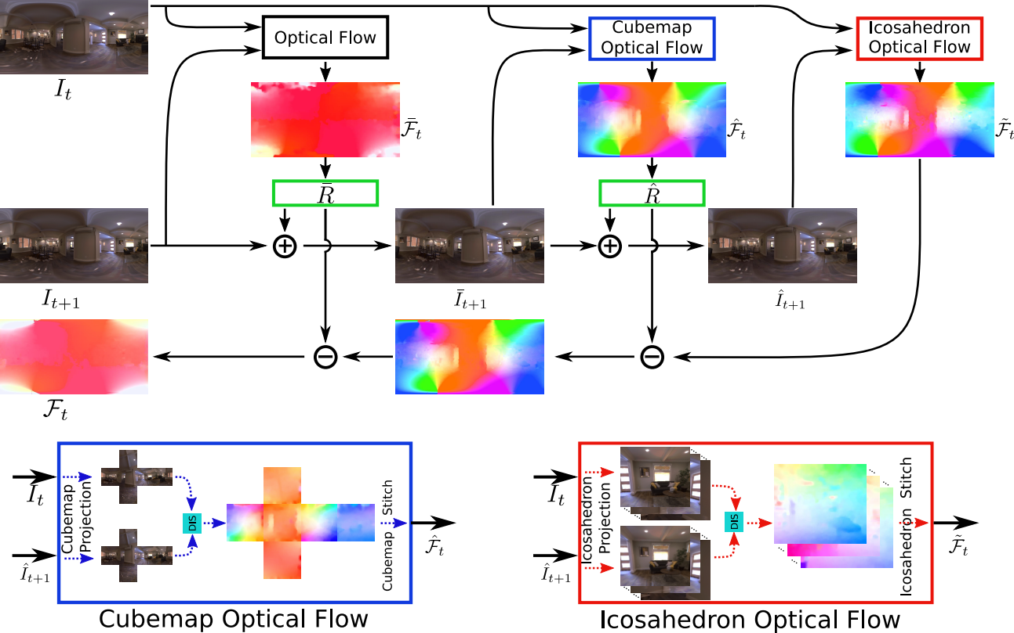
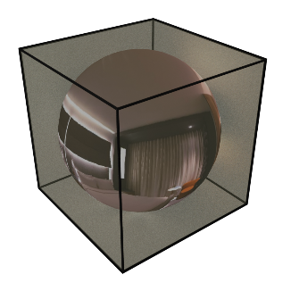
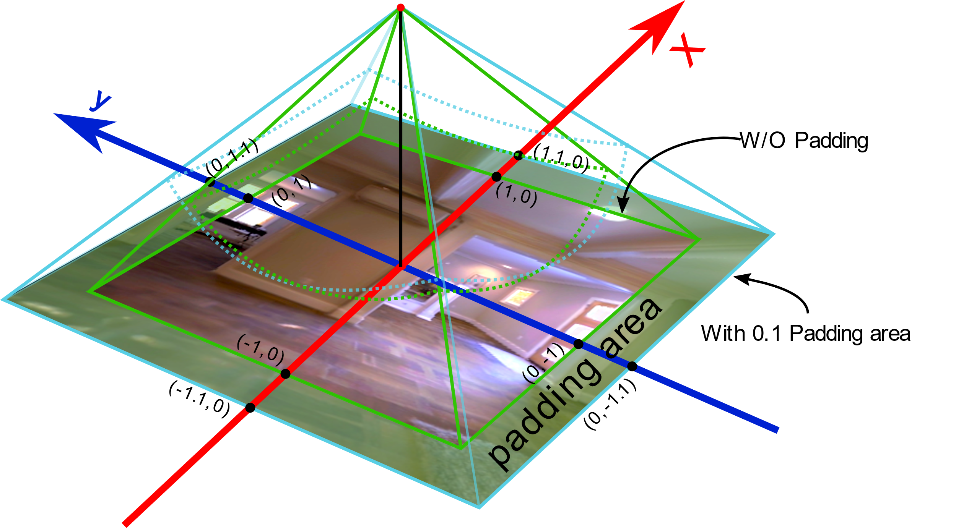
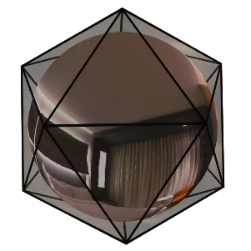
Method – Generate perspective images
360 Optical Flow using Tangent Images, MZ Yuan and C Richardt
BMVC 2021
Page 6
Notes:
To uniformly sample the pixels in the 360° images, we project them to perspective images that are tangent to the faces of first a cubemap and then an icosahedron.
We use gnomonic projection to project pixel from a spherical image to the tangent images.
For better optical flow consistency across adjacent tangent images, we pad the tangent images and use the colour difference to blend optical flow predictions in the overlapping regions.

Slide 7
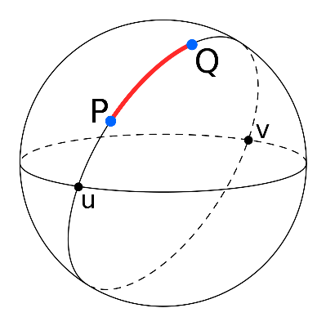


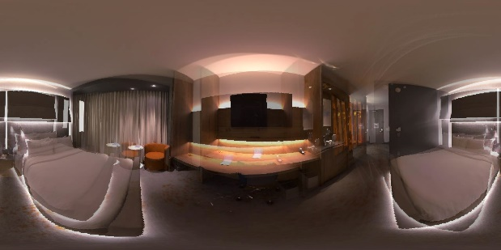


Result
Geodesic distance-based Error Metric:
SEPE, SAAE, SRME
Ours
OmniFlownet
RGB Images
PWCNet
RAFT
SEPE heatmap
360 Optical Flow using Tangent Images, MZ Yuan and C Richardt
BMVC 2021
Page 7
Notes:
To measure the quality of 360° optical flow, we propose spherical error metrics on the unit sphere using the geodesic distance instead of Euclidean distance, which correctly handle distortions and wrap-around.
Here, we visualize optical flow errors using the spherical end-point error, or SEPE.
## Propose SEPE, SAAE and SRME.
Our experimental results show that our method can dramatically improve the quality of 360° optical flow, especially at the top and bottom of 360° images.

